Slide 1
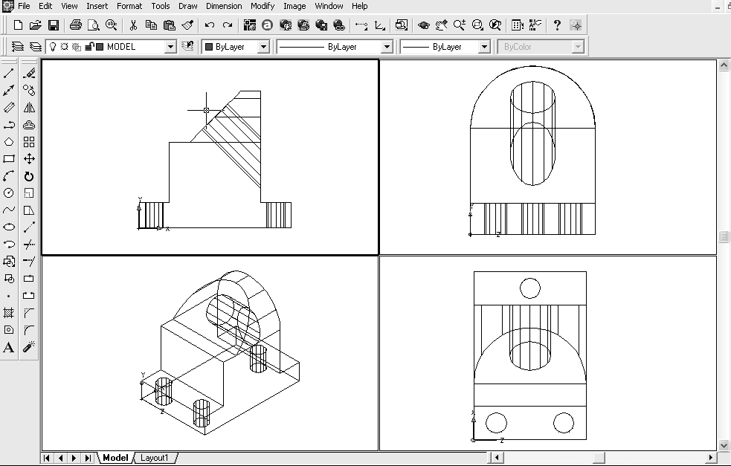
Week 2
Consolidate last week’s work
One new topic
  Viewports
    Can see many views at once
Viewports exercise
  Open Machine Support
  Veiw, Viewports, 4
  Click in lower left viewport
  View, 3D Views, SE Isometric
  Complete for other viewports
Q: If I have more than one UCS, which one will be current in each viewport?
A: Read the UCSVP notes.

Slide 2
Practice drawing (in this order)
First
  3D Solid Model notes
    Exercise 1
    Exercise 2
Second
    Cross (draw the cross in 2D, then make a new layer, Draw, Boundary, extrude)
    U-shaped bracket
Third
    Machine Support using the notes
    Machine Support without using the notes
If you have time (and enough energy)
    CE/M/99
Section completed
    4.1.2
Remember to name, date and save your drawings. Then print them out and file them.

